Slide 1

Aging of Russian WWER reactors
Dr. G. Kastchiev, E. Seidelberger
Consultants at the Institute of Safety and Risk Sciences,
University of Natural Resources and Life Sciences Vienna
INRAG Study – “Risks of lifetime extensions of old nuclear power plants”, April 26, 2021, Online

Slide 2
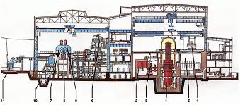
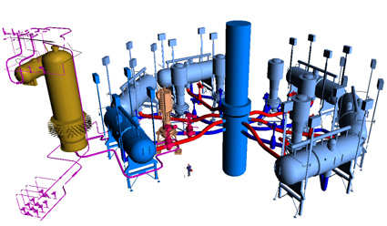
Mediam sized WWERs
440 MW
First generation WWER-440/V-230
Prototyps:
70 MW - 1966
210 MW - 1964
365 MW – 1969
417 MW - 1971
All units in Bulgaria, Slovakia, former GDR finally shut down
Still four reactors in operation - three in Russia and one in Armenia

Slide 3

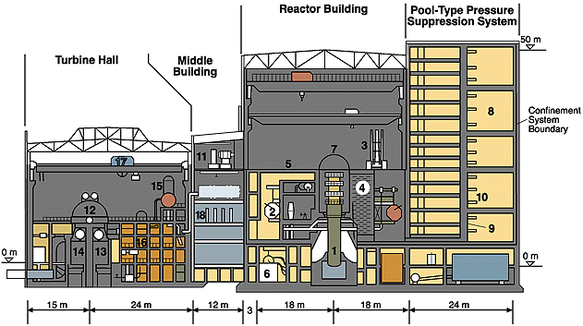
Mediam sized WWERs
440 MW
Second generation WWER-440/V-213
6 cooling loops;
localization tower for each unit;
full set of passive (accumulators) and active core cooling systems;

Slide 4
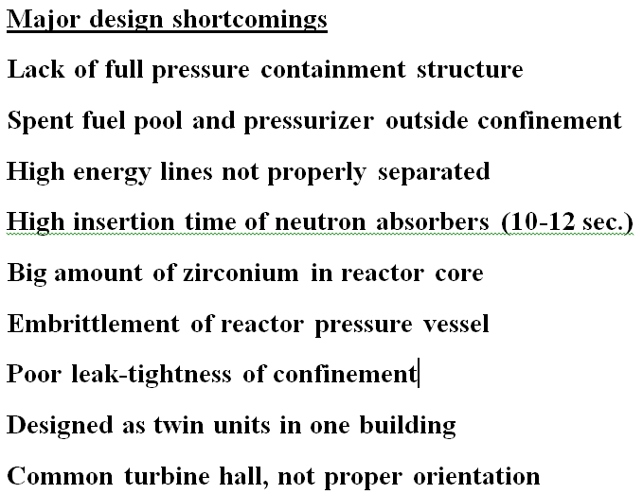
Mediam sized WWERs
440 / V-213
16 units in operation:
Kola 3&4, 1981-1984, Russia
Rovno 1&2, 1980-1981, Ukraine
Paks 1&4, 1982 – 1987, Hungary
Dukovany 1&4, 1985-1987, Czech Republic
Bohunice 3&4, 1984-1985, Slovakia
Mochovce 1&2, 1998-1999, Slovakia
14 units operated after their initial design life

Slide 5
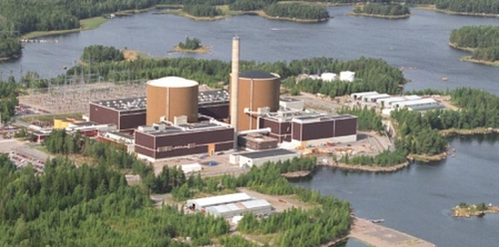
Mediam sized WWERs
440 / V-213
Loviisa Finland
Modernized at very early stage
Containment structure
Loviisa 1&2, 1977 – 1980
In addition:
NPP Greifswald, former GDR, 1989
One unit in operation, shutdown 1989
Three units in construction, all activities stopped

Slide 6
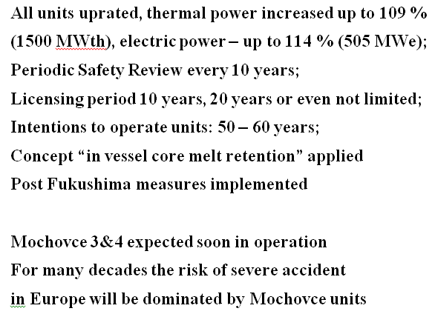
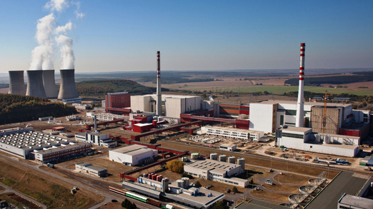
Mediam sized WWERs
440 / V-213
Mochovce NPP

Slide 7
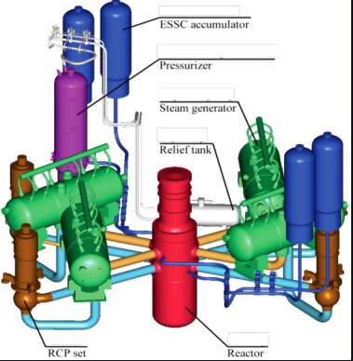
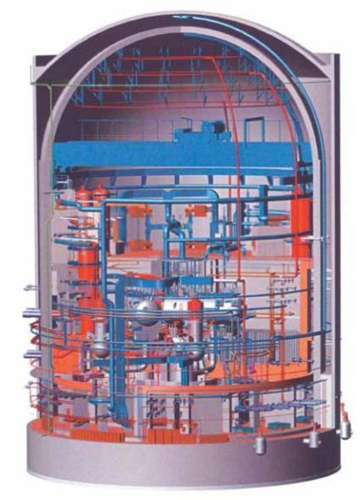
WWERs
Big reactors
WWER-1000/V-320
Four cooling loops, full set of active and passive core cooling systems, single containment structure
Prototyps:
V-187, one unit, 1980, Russia
V-302 and V-338: so-called "small series", 5 units.
30 units in operation: Russia (13), Ukraine (13), Czech Republic (2) and Bulgaria (2)
Design life – 30 years, 17 units operated after their initial design life, few are approaching

Slide 8
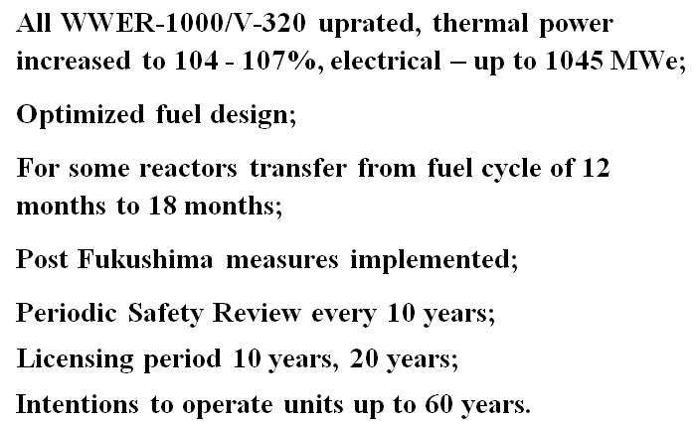
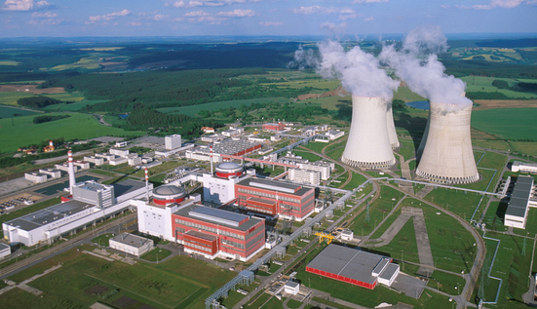
WWERs
Big reactors
WWER-1000/V-320
Temelin NPP

Slide 9
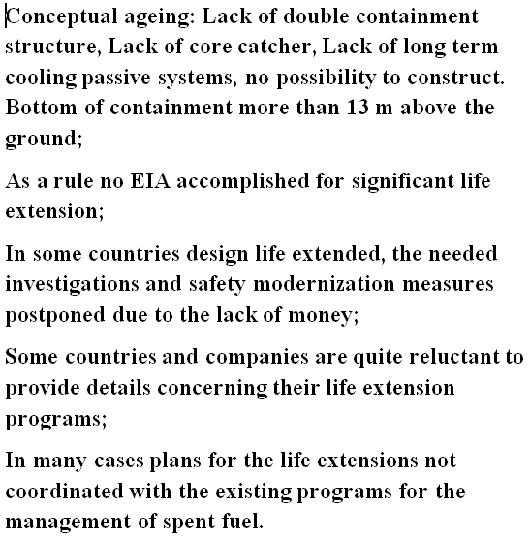
WWERs
Big reactors
WWER-1000/V-320
Some safety issues of prolonged operation

Slide 10
Russian WWER reactors -
Severe Accident Management (SAM) approach
Original Design Base and Conceptual Aging
of generation II reactors Safety Concept
Severe Accident Management Concepts for WWER reactors
Approaches and imponderables
WWER 414/V-213
  WWER 1000/V-230

Slide 11
Original Design Base
Safety philosophy ~ 1970
Prevention and control of abnormal conditions and accidents applying a DID concept
Design Base Accident (DBA)
Maximum credible accident
  Hypothetical double - ended guillotine break of main coolant pipe
  Complete Loss of Coolant (LOCA)
Controllability of DBA
  Shut down of chain reaction
  Refill and reflood of the reactor core
  Removal of decay heat from reactor
  Reactor core integrity is maintained
  Core meltdown is prevented
  No radioactive off-site releases and contamination
DBA concept for currently operating
Light Water Reactors (LWRs) of generation II
Original Design Base
Safety philosophy
Design Base Accident
Controllability

Slide 12
Conceptual Aging of generation II LWRs Safety Concept
Source: WENRA RHWG 2009, modification by E. Seidelberger
DID Safety Concept | Level of Defence in Depth | Objective of the level | Essential means | Associated plant/off site conditions
Original design of a generation II plant 1970s | Level 1 | Prevention of abnormal operation and failure | Conservative design and high quality in construction and operation | Normal operation
 | Level 2 | Control of abnormal operation and failure | Control, limiting and protection systems and other surveillance features | Anticipated operational occurrences
 | Level 3 | Control of accident within the design basis | Engineered safety features and accident procedures | Hypothetical Design Base Accident (DBA) (postulated single initiating events and failures)
Contitions beyond original design 1979/86/2011 | Level 4 | Control of severe plant conditions that were not explicitely addressed in the original design of currently operating plants owing to their very low probabilities | Complementary measures and accident management | Multiple failures SEVERE ACCIDENT with reactor core melt
Off-site Emergency Planning and Provisions | Level 5 | Mitigation of radiological consequences due to significant releases | Off-site emergency response Intervention levels | Significant radiological off- site contamination
DID Concept extension from 3 to 5 Levels
triggerd by real Severe Accidents
TMI 1979,
Chernobyl 1986,
Fukushima 2011

Slide 13
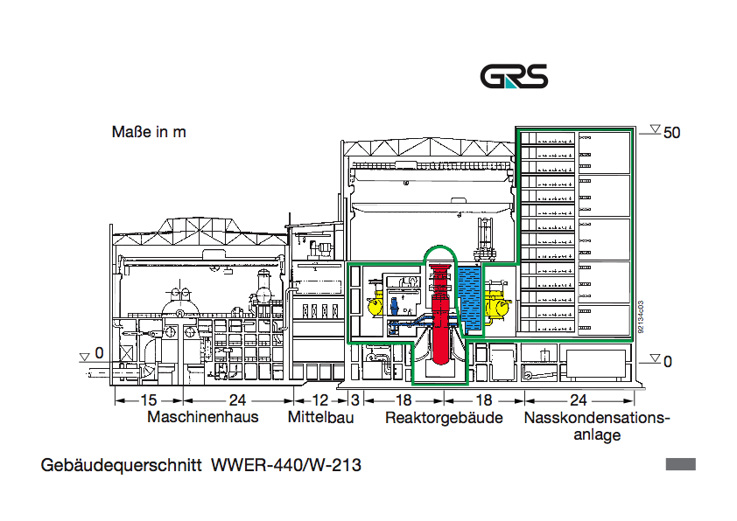
VVER 440/213
Source: GRS, modification by E. Seidelberger
Critical areas overview
with special Severe Accident relevance
Spent fuel storage pool
outside confinement
Critical area indicator

Slide 14
VVER 440/V-213 Concept for Core-Melt-Retention in Reactor Pressure Vessel
(IVMR)
Source: Slovak Stress Test Report 2011, Mochovce 3/4, 2016, modification by E. Seidelberger
Critical area indicator
Severe Accident with core melt -
Aim: retention of core melt in vessel
Measure: Flooding of the reactor shaft with water to cool RPV from outside and avoid melt penetration
Imponderables, uncertainties: Core melt bahviour and heat production inside, coolant availability outside in time, critical heatflux (Leidenfrost), obstructions for gravity feed- water-steam circulation, long- term cooling capability and RPV wall strength, failure of RPV, steam-explosion, etc.

Slide 15
WWER 1000/V-320
Source: In-Vessel Melt Retention (IVMR) Analysis of a VVER-1000 NPP, 2016, modification by E. Seidelberger
Severe Accident with core melt -
Aim: core melt management in- /outside RPV
Measures: not yet decided, still unknown
Containment structure unfavorable for core melt retention because bottom plate above ground
Imponderables, uncertainties to be taken into account, same/similar as/to WWER 440/V-213
Critical area indicator

Slide 16
Thank you for your attention !

